Slide 1
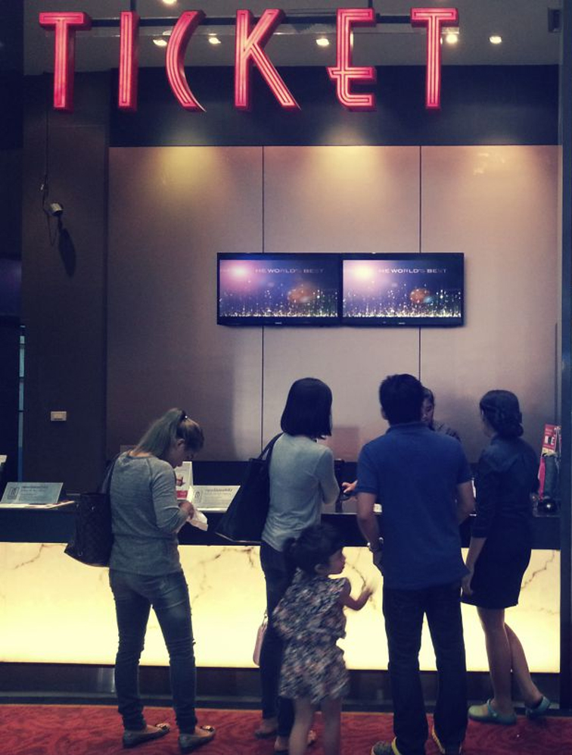
“MOVIE TICKET BOOKING
SYSTEM"
Presented by,
MD ZIHAD
ID: 0112330577
SHOHAN
ID: 0112330605

Slide 2

TABLE OF CONTENTS:
This simple program will make the Ticket Booking system ease. The program has 5 main functions:
Login
Add Movie
View Movie List
Book Tickets
Generate Bill

Slide 3
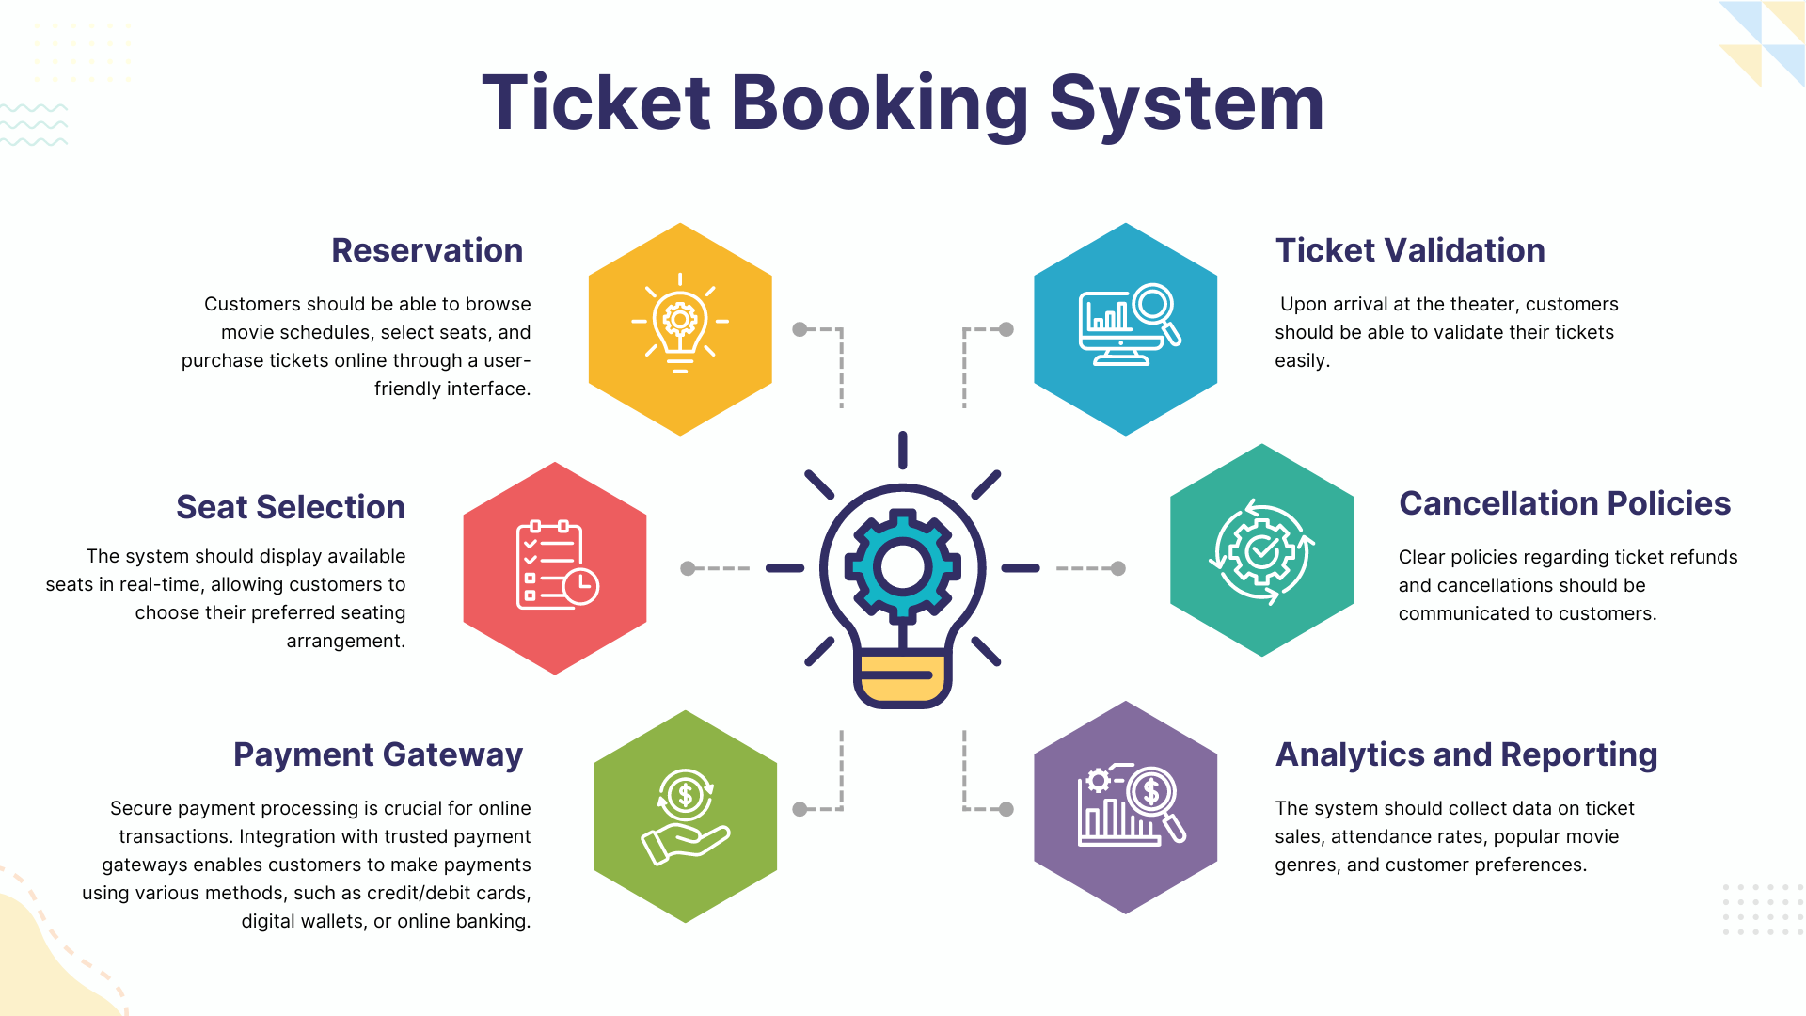

Slide 4
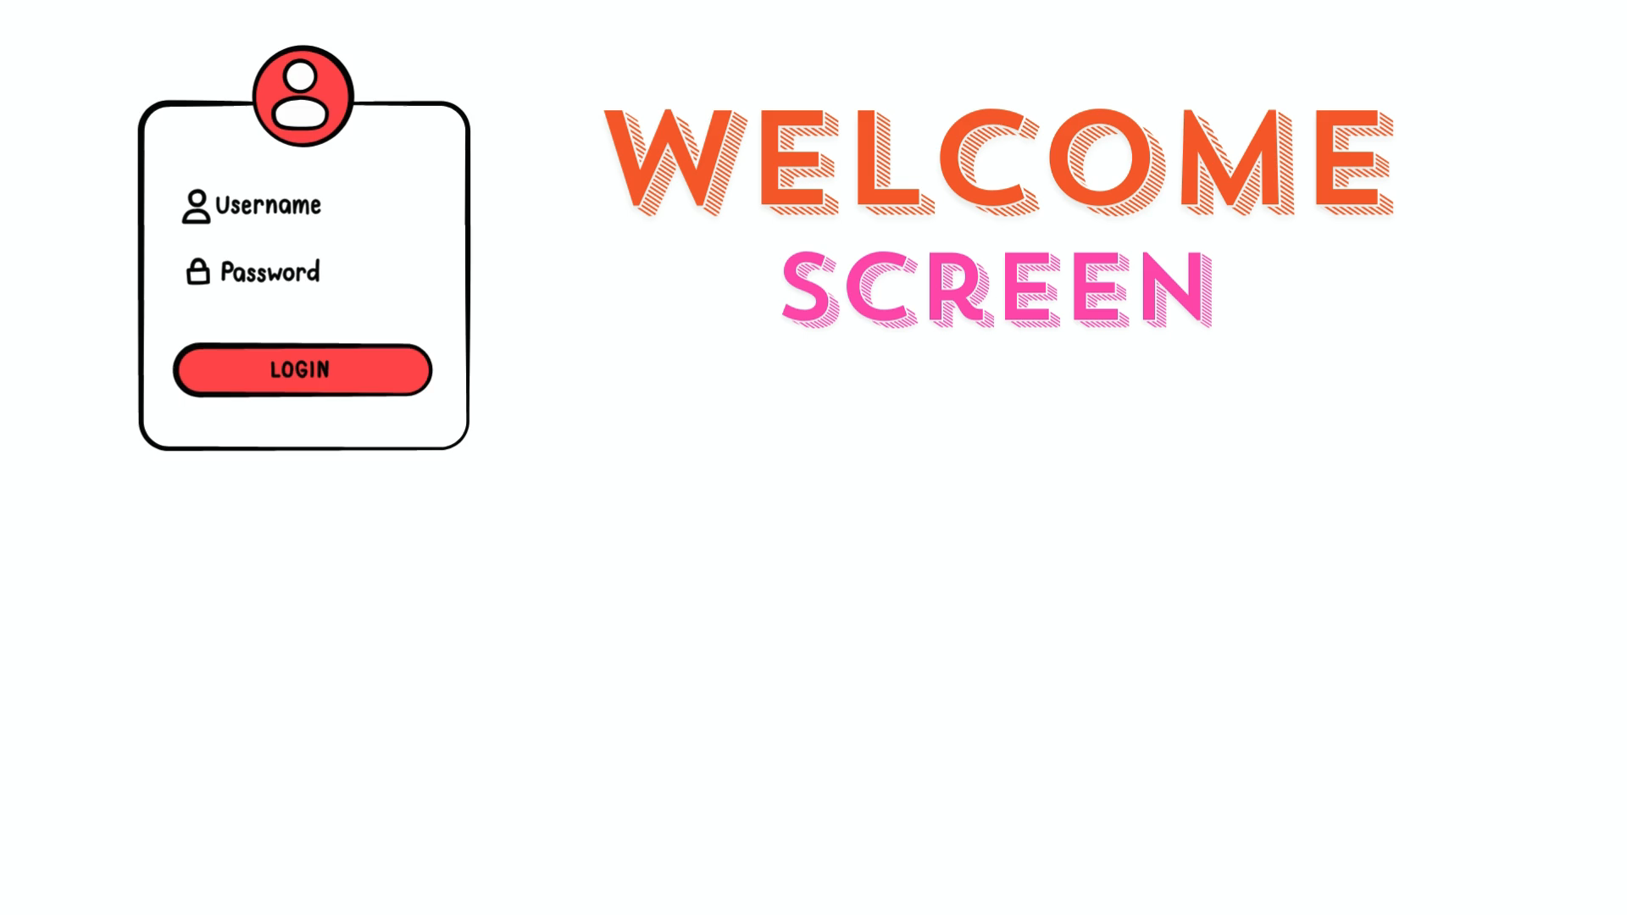


Slide 5
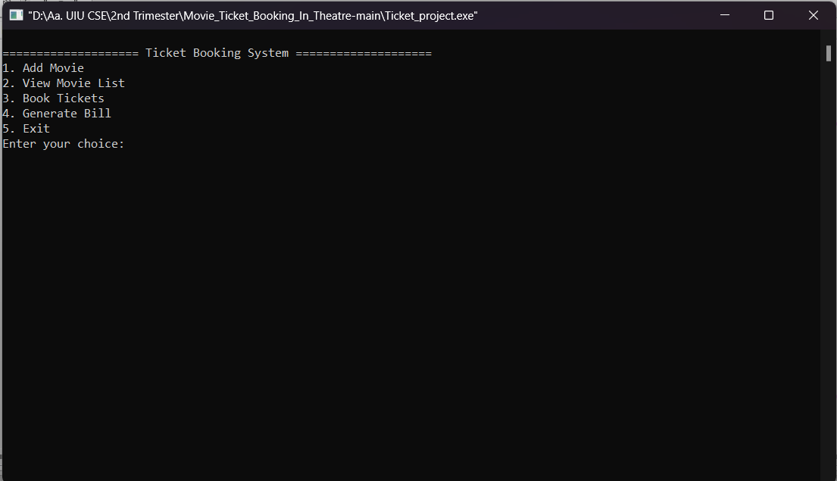

Main interface

Slide 6
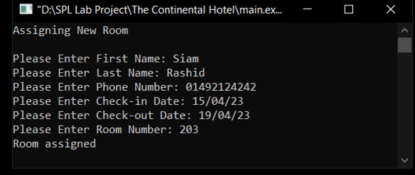
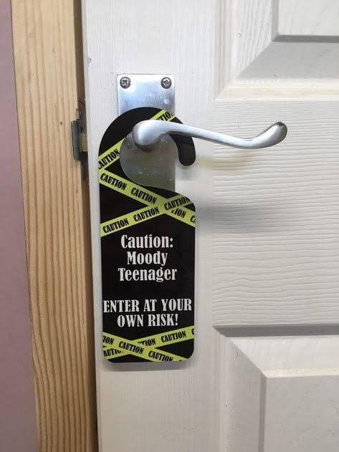


Adding new entry

Slide 7
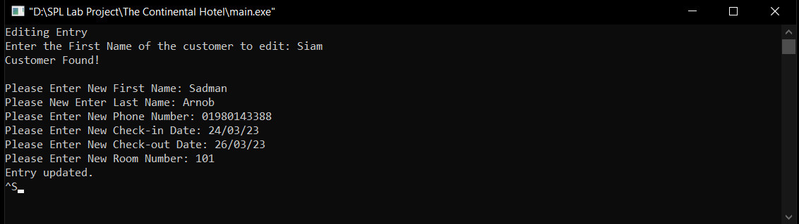

Editing Entry

Slide 8
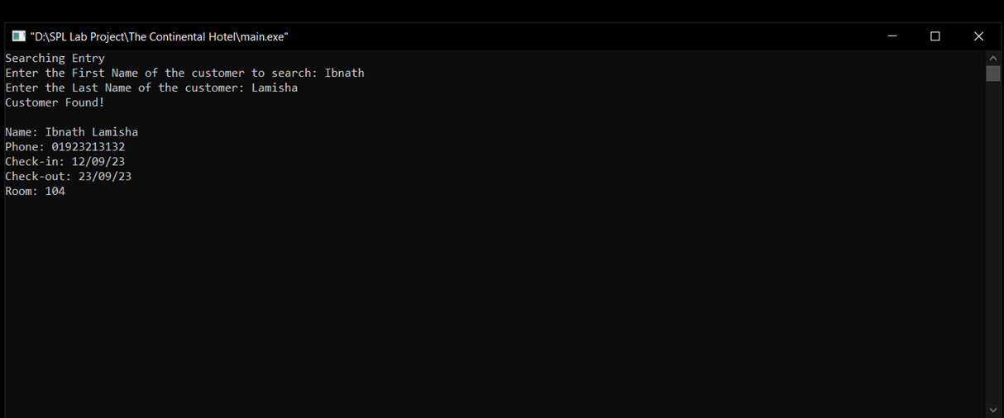

Searching Entry

Slide 9
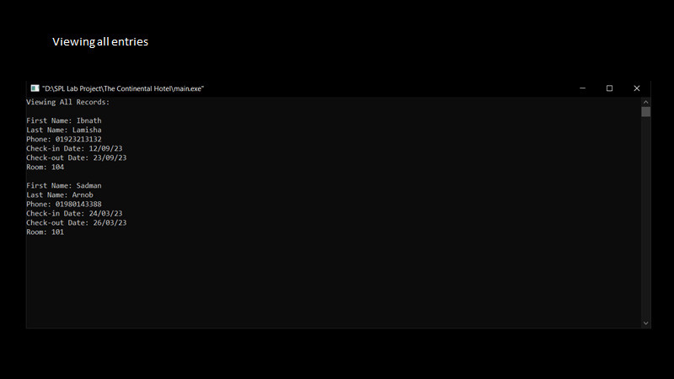
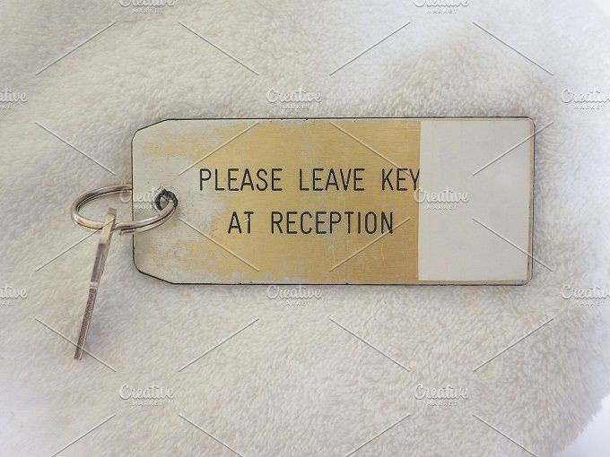
Viewing all records

Slide 10
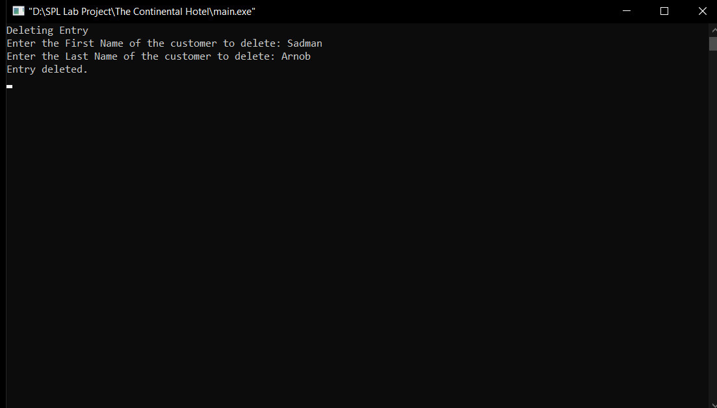

Delete Entry

Slide 11

Now it's time to leave.
Thank you all for your patience.

